Slide 2
" In The Name of Allah, The Most Beneficent, The Most Merciful" Pitfalls in Halal standards How Important is real Halal to You? By: Dr. Hani M. Al-Mazeedi

Slide 3
Opening Speech
The consumer has the right to know
من حق المستهلك أن يعرف
And consumer are deliberately made not to know
ويتم عمداً جعل المستهلك لا يعرف

Slide 4
Scope:
This presentation focuses on Halal standards with emphasis on the excuses that it may contain in some of their clauses that definitely will allow non-Halal practices¹, and non-Halal ingredients² to penetrate into Muslim markets under legal frame.

Slide 5
Content
Introduction
Definitions
Statements from Halal fatwas and Halal standards
Comments
Solutions
Conclusions
Recommendations

Slide 6
Introduction
Halal standards are references, the law, the criteria that differentiate between what is acceptable from what is not acceptable in any trades.
It is the contract between three parties: the service or product requester¹, the service or product provider² and regulating agencies³ within the importing country (the end user).

Slide 7
Standards provide comprehensive guidelines in a form of clauses¹ and related standard references² as indispensable for the application of the standard.
Halal standards incorporate Islamic schools of thought (Mazhabs) ¹ and regional Halal regulations² for consumer protection against nonconforming products or services.

Slide 8
An important part of Halal standards process has the goal to demonstrate the Halal competency¹, impartiality², independence³ and unnecessary need for reconfirmation⁴ of the Halal process with a third party.
Halal standards serve as a basic requirements for Halal products or service of food¹ and non-food² products (logistics, cosmetics, pharmaceuticals and animal feed under Halal).

Slide 9
Halal fatwas and Halal standards, or so called Halal, some of which have few pitfalls in their clauses under the cover of excuses.
Excuses that one may find in Halal fatwas and Halal standards are: expedient مناسب¹, not recommended غير مستحسن ², if necessary إذا لزم الأمر ³, small amounts كميات صغيرة ⁴, negligible amounts كميات لا تذكر ⁵, and synthetic إصطناعية ⁶.

Slide 10
Such pitfalls are due to ignorance and/or debatable issues such as: Ahlul Kitab/kitabi (the people of the book) ¹, stunning prior or after slaughtering², mechanical slaughtering³, Istihala (physiochemical transformation or conversion) of the core Najis substance to another substance⁴, and alcohol⁵.

Slide 11
Halal standards must be reviewed and amended to suit not only one all Muslim Mazhab but all Mazhabs.
Halal standards that are based on one specific mazhab is a weak standard, and will serve, in most cases, non-Islamic acts of the industry, and few examples will be given.

Slide 12
Definitions
Ahlul Kitab
Ahlul Kitab/kitabi is an Islamic term refers to the Jews¹اليهود , and the Christians²النصارى .
Ahlul Kitab’s scriptures referred to in the Quran are the Torah (At-Tawraat)¹, and the Gospel (Al-Injiil)².

Slide 13
Statements that must be changed in Halal standards
Statements related to the religion of the slaughter man
GSO 993 / 1998
3.2.1 The slaughterer must be Muslim or Kitabi (Jewish or Christian).
Kitabi = Ahlul Kitab

Slide 14
Comments
Ahlulkitab/Kitabi is a controversial issues among Muslims:
In Shafei mazhab, according to their definition, Ahlulkitab/Kitabi do not exist any more.
To some of the Sunni mazhab, based on their observations, they believe that at present Ahlulkitab/Kitabi are apostate from their religion.
With Shiite belief, based on their interpretation of the Quran, they do not see that the slaughter of Ahlulkitab/Kitabi is Halal.

Slide 15
Solution
Halal standards are not Fatwas, they are regulations in a form of clauses, nothing to fear if the clause 3.2.1 in GSO 993 / 1998 is changed from:
The slaughterer must be Muslim or Kitabi (Jewish or Christian), to
The slaughterer must be only Muslim

Slide 16
The issue of stunning
Definition of Stunning
Practically, stunning is a pre-slaughtering method that makes the animal or bird at the time of slaughter motionless.

Slide 17
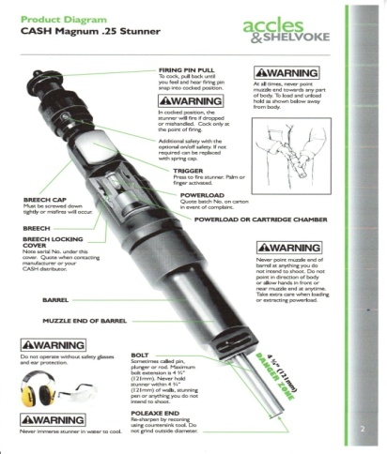
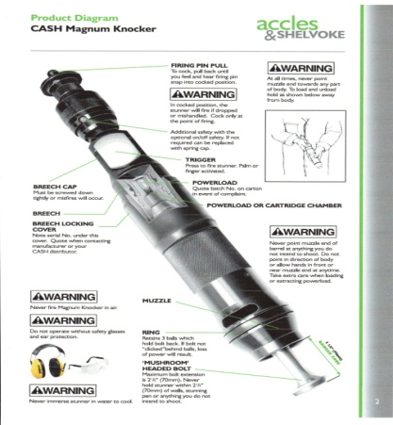
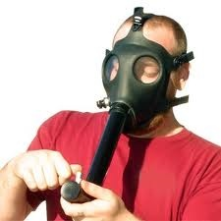
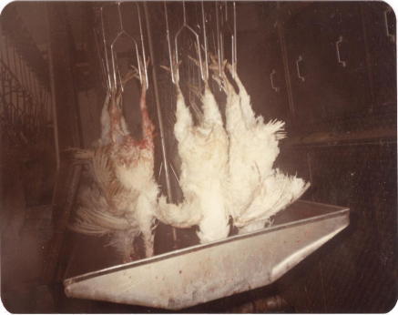
Examples of pre-slaughtering methods (or stunning methods)
Captive-bolt shot into the brain
Mushroom gun shot into the head*
Electric stunning using a water-bath
Electric shock
Controlled atmosphere Killing (CAK) using gas mixtures.
*Percussion stunning ,or air gun stunning

Slide 18
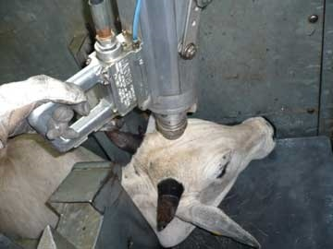
Comments
What is the effect of stunning on animal/bird before slaughter?
If percussive captive bolt or Mushroom stunner are used and the stunned animals left without slaughtering they will not go back to life (i.e., Mawqoozah موقوذة).

Slide 19
It is difficult to ensure a 100% Halal control of birds with stunning because:
Any changes in the trend or the frequency or distance or weight or resistance, or the amount of hear/feathers on the body will result in a mortality rate value ​​that cannot be tolerated from the standpoint of their religious legitimacy.
*Kettlewell, P.J. and Hallworth R.N. (1990). Review paper, Electrical stunning of chickens. J. agric. Engng Res. 47, 139-151.

Slide 20
No implementation of Halal standards
Statements in Halal standards
GSO 993 / 1998
3.2.6 Beating on head or similar action, such as using of bolt shot pistol or non penetrative percussion or stunning by carbon dioxide is not permitted.
STANDARDIZATION ORGANIZATION FOR G.C.C (GSO)
GSO 993 / 1998
اشتراطات ذبح الحيوان
طبقا لأحكام الشريعة الإسلامية
ANIMAL SLAUGHTERING REQUIREMENTS
ACCORDING TO ISLAMIC LAWئ

Slide 21
How the Australian or South African cows treated before neck cut?
Cows are beaten on head by mushroom guns. Most of the beef in GCC are from Australia mushroom head beaten certified as Halal by Australian Halal certification bodies.

Slide 22
GSO 993 / 1998
3.2.7 Electrical stunning is not allowed in case of birds Since it was proven by experience that this led to the death of quite a few of them before slaughter.

Slide 23
How are poultry from around the world is being treated before neck cut and exported to GCC?
All poultry from around the world even Turkey and lately Saudi Arabia and UAE perform stunning before or after slaughter.

Slide 24
Other Halal standards
TAS 8400-2007
THAI AGRICULTURAL STANDARD
HALAL FOOD
3.2.2 Stunning animal before slaughtering is not recommended. If necessary, any stunning is to be made, the requirements described in Annex B need to be observed.
ANNEX B
B.3 Mechanical Stunning
(2) Non-penetrative stunner (for example, mushroom head type) is allowed for use.

Slide 25
TAS 8400-2007
THAI AGRICULTURAL STANDARD
HALAL FOOD
B.3 Mechanical Stunning
(3) Stunner shall not be penetrative or cause skull fracture to avoid permanent injury in animal.
Comments on this Halal standard
All non-penetrative stunner in most cases causes skull fracture, permanent injury, complications and ultimately death in animal within the range of 15-75%.

Slide 26
Solution
Implementation of the GSO 993 / 1998 clauses 3.2.6 and 3.2.7.
All forms of stunning must be prohibited for use.
Modern slaughterhouses must be improved to non-stun.

Slide 27
Contradictions in Halal Fatwas
IIFA Resolution # 95 (3/10) in Clause Fifth/C and Eight
Clause Fifth/C Electrical stunning is not allowed in case of birds Since it was proven by experience that this led to the death of quite a few of them before slaughter.
Clause Eighth The basis of poultry slaughtering is to be performed by hand of the slaughtermen, and it is ok to use mechanical machines in the poultry….

Slide 28
Comments
How can that be?
One can not do mechanical slaughtering without stunning!!
Clause eighth contradict with clause fifth/C!!!
This is a proof that mechanical slaughtering by this standard is prohibited and/or stunning of bird are allowed.

Slide 29
Also a proof that Halal standards GSO 993 / 1998 clauses 3.2.6 and 3.2.7 that are based on this fatwa and other Fatwas in Halal in general are formulated by scholars who have no past experience with immerging issues related to Halal¹ and no past experience with western slaughterhouses².

Slide 30
Contradictions in Halal standards
OIC/SMIIC 1: 2011
General Guidelines on Halal Food
5.2.5 Stunning
All forms of stunning and concussion (loss of consciousness) shall be prohibited. However when the use of the electric shock becomes necessary and expedient (such as calming down or resisting violence by the animal), the allowed period and the electric current value for stunning shall be in accordance with Annex A of this standard.
Stunning (loss of consciousness) of poultry is prohibited, however if it is necessary and expedient the following conditions shall be met:
Poultry shall be alive and in stable condition during and after stunning (loss of consciousness) and upon slaughtering,
The current and duration of the electric shock, if it is used, shall be as specified in Annex A,
Any poultry that die before the act of slaughtering shall be considered as dead and unlawful, Shall be proven to be humane,
Shall not reduce the amount of blood after slaughtering.

Slide 31
No commitments with Halal standards
OIC/SMIIC 1: 2011
General Guidelines on Halal Food
5.2.6.2.3.1 Mechanical slaughter
Mechanical slaughtering could be used with existence of a validation system. Proper labelling shall be applied on the product showing that it is mechanical slaughtered.
The operator of the mechanical knife shall be an adult Muslim,
The slaughterer shall recite Tasmiyah “BISMILLAH” prior to switching on the mechanical knife and shall not leave the slaughter area,
Comments
Never ever on any package of any poultry is written that it has been mechanically slaughtered or even stunned.

Slide 32
Stunning is prevailed with Halal standards
MS 1500 (2009) (English): HALAL FOOD - PRODUCTION, PREPARATION, HANDLING AND STORAGE - GENERAL GUIDELINES (SECOND REVISION)
Table A 1 Guideline parameters for electrical stunning of chicken and bull ....... 13

Slide 33
Only few Halal standards strict stunning
PBD 24 : 2006
PIAWAI BRUNEI DARUSSALAM
BRUNEI DARUSSALAM STANDARD
Brunei Darussalam Standard
For Halal Food
3.2.5.2 Stunning
Stunning for poultry is prohibited.
Is it being implemented?!

Slide 34
Mechanical Slaughtering
Facts
The actual slaughter of chickens is performed by automated machine without any direct human action.
Conditions of religion¹, intellect² and Tasmiyah³ are absent.
Invoking Tasmiyah at slaughter point is absent.
If distracted, the invoker misses many chickens.

Slide 35
Comments
Does Mechanical Slaughtering meet Halal conditions?
The specified vessels are cut most of the time.
Sometimes the neck is cut off entirely.
Sometimes the required vessels are only partially severed.
Sometimes the blade cuts the head, wings or breast of the chicken.
Sometime the chicken avoids the blade altogether.

Slide 36
Istihala
Istihala can be best defined as the non deliberate* Physiochemical Transformation or conversion of material to another material which involves complete change of the core substance of unlawful, Haram, Najis إنقلاب عين النجس in its physical and chemical properties to another substance that have:
different name¹, different physical properties², and totally 100% change in its chemical properties³.
*Without human intervention or intention or natural conversion.

Slide 37
Statements from fatwas
The presence of Najis materials is not allowed, however, if present in minute amounts, such as enzymes, this is called: a form of transformation or a case that is subjected to the theory of consumption, i.e. Istihala إستحالة.
What follows is that there presence is allowed! Without paying attention to their effect of such minute amounts in processing such as Najis rennet in cheese making.

Slide 38
Indirect statements from standards
MS 2424: 2012
4.15.1 Synthesized materials
The sources and processing of synthesized materials shall comply with halal requirements. The usage of synthetic alcohol is permissible.
The Malaysian standard is based on Shafei Mazhab that looks at alcohol regardless of its sources as Najis, here in this Malaysian standard its allow the use of only synthetic alcohol, however, and in small amounts, as its may be looks at it as negligible, Allah جل جلاله knows best.

Slide 39
Alcohol
Alcohol (ethyl alcohol) is a liquid intoxicating substance.
An intoxicating substance once it is used it means that man’s intellect stops functioning properly.
In Islam, it is Haram to use any kind of intoxicant.
The issue of the physical Najis (impure) of alcohol is a debatable issue among the followers of all mazhabs.

Slide 40
Some Mazhabs are a strict believer that Alcohol regardless of its sources is physically Najis.
Some Mazhabs are a strict believer that Alcohol is not physically Najis at all regardless of its sources.
Some are strict believer that Alcohol is not physically Najis if it is from sources other than grape or date fermentation.

Slide 41
Statements in Halal standards
MS 2200: PART 1:2008
4.1.4 Alcohol
Materials for cosmetic and personal care that contain alcohol excluding alcoholic drinks (khamar) are permissible.
4.1.5 Synthetic
Materials for cosmetic and personal care produced synthetically are halal

Slide 42
MS 2424: 2012
4.15.1 Synthesized materials
The sources and processing of synthesized materials shall comply with halal requirements. The usage of synthetic alcohol is permissible.
The Malaysian standard is based on Shafei Mazhab that looks at alcohol regardless of its sources as Najis, here in this Malaysian standard its allow the use of only synthetic alcohol, however, and in small amounts, as its may be looks at it as negligible, Allah جل جلاله knows best.

Slide 43
Comments
Those Mazhabs who are strict believer that Alcohol is not physically Najis at all regardless of its sources appears to be the most practical and appropriate view in terms of the current Halal industry, under the condition that their fatwa on alcohol as not physically Najis stand on a sound strong ground.

Slide 44
Solution
To make Halal standards acceptable to all Mazhabs it should have a clear statement that read this way:
Materials that contain alcohol regardless of its sources are not permissible.
Halal alternatives to Alcohol as a solvent is available, however, no one care to ask.

Slide 45
Conclusion
The real Halal can only be achieved by going strict Halal.
Halal awareness is the key to solve many Halal issues.
Alternatives to Haram can be provided in robust amounts.
Under normal circumstances, Haram materials are not allowed to be used for any purpose.
Orders of Allah almighty delivered to us to implement them and not for maneuvering around them.
Practically accredited Halal certification bodies are not under control of Halal accreditation bodies.
Halal accreditation bodies are involved in Halal businesswise.

Slide 46
Recommendations
Assessment of Halal Awareness must be conducted routinely.
Halal awareness programs must be established at early educations.
Muslim consumers should be educated on Halal terminologies and what do they imply in their daily life.
Muslim consumers should not rely totally in Halal on their governmental control agencies; they must depend on themselves by questioning before buy.
Governments should request from international companies to provide the real Halal on food and non-food items.

Slide 47
Muslim scholars should unite with one opinion on Halal and Haram on emerging issues.
Accreditation agencies must reorient themselves to focus mainly on Halal rather than solely on the requirements of quality management systems.
Finally, government bodies concerned in pursuing halal should establish a deterrent punishments عقوبات رادعة to anyone who begs يسول himself by passing transactions for non-conformity Halal shipments.

Slide 48
References
This article was originally written in Arabic and taken from the book “My Food, under review for 2018”, by its author Dr. Hani Mansour Mosa Al-Mazeedi. Kuwait Institute for Scientific Research.
Mufti Syed Arif Ali Shah (2017), The shari’ah laws regarding Alcohol in light of the Quran, Sunnah and Islamic jurisprudence, SANHA Halal Associates Pakistan.
MS 1500 (2009) (English): HALAL FOOD - PRODUCTION, PREPARATION, HANDLING AND STORAGE - GENERAL GUIDELINES (SECOND REVISION).
MS 2200-1 (2008) (English): ISLAMIC CONSUMER GOODS - PART 1: COSMETIC AND PERSONAL CARE - GENERAL GUIDELINES.
MS 2424 (2012) (English): Halal Pharmaceuticals - General guidelines
GSO 993 / 1998, ANIMAL SLAUGHTERING REQUIREMENTS ACCORDING TO ISLAMIC LAW
PBD 24 : 2006 , PIAWAI BRUNEI DARUSSALAM BRUNEI DARUSSALAM STANDARD, Brunei Darussalam Standard For Halal Food.
OIC/SMIIC 1: 2011, General Guidelines on Halal Food.
IIFA Resolution # 95 (3/10)
TAS 8400-2007, THAI AGRICULTURAL STANDARD, HALAL FOOD
The Central Islamic Committee of Thailand General Guidelines on Halal Products, THS 24000: 2552

Slide 49
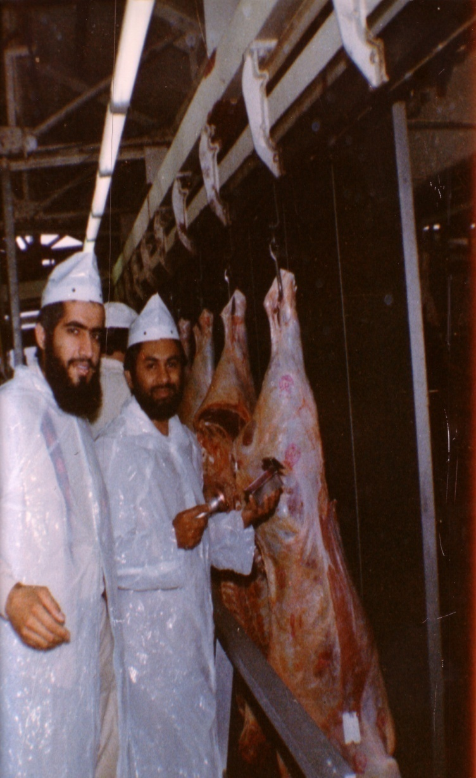
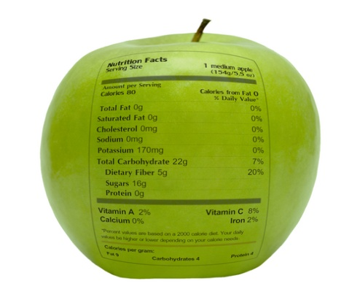
شكراً لاستماعكم
سبحنك اللهم وبحمدك أشهد أن لا إله إلا أنت، أستغفرك وأتوب إليك
د. هاني منصور المزيدي
مع الأخ أمجد محبوب في أستراليا سنة 1981
Dr. Hani Mansour Al-Mazeedi
With brother Amjad Mahboob in Australia in 1981

Slide 50
www.HalalEA.com
Trademarks, icons, images belong to their respective owners.
© Halal Sciences Academy Limited

